Slide 1


Hugues LONLA
01/05/2024

Slide 2
Outline
Executive Summary
Introduction
Methodology
Results
Conclusion
Appendix

Slide 3
Executive Summary
Our project focuses on predicting the success of SpaceX Falcon 9 first stage landings to optimize rocket launch costs.
We collected and analyzed data using data science techniques, identifying key factors influencing landing outcomes.
Results show our model's effectiveness in forecasting landings accurately, offering valuable insights for cost optimization in rocket launches.
This underscores the importance of data-driven approaches in advancing space exploration.

Slide 4
Introduction
SpaceX's Falcon 9 rocket revolutionized space exploration with its reusable first stage, significantly reducing launch costs.
However, the unpredictability of first stage landings poses challenges, impacting cost optimization and launch efficiency.
In this project, we aim to predict Falcon 9 first stage landing success using data science techniques to enhance launch planning and cost-effectiveness.

Slide 5

Section 1

Slide 6
Methodology
Executive Summary
Data Collection: Retrieved telemetry data and mission details from SpaceX API using Python.
Data Processing: Cleaned and prepared collected data for analysis.
EDA: Utilized visualization and SQL for exploratory data analysis.
Interactive Visual Analytics: Implemented Folium and Plotly Dash for interactive visualizations.
Predictive Analysis: Developed, tuned, and evaluated classification models to predict landing outcomes.

Slide 7

Data Collection
Data Collection Routes
spacex_url="https://api.spacexdata.com/v4/launches/past"
wiki_url="https://en.wikipedia.org/w/index.php?title=List_of_Falcon_9_and_Falcon_Heavy_launches&oldid=1027686922"

Slide 8
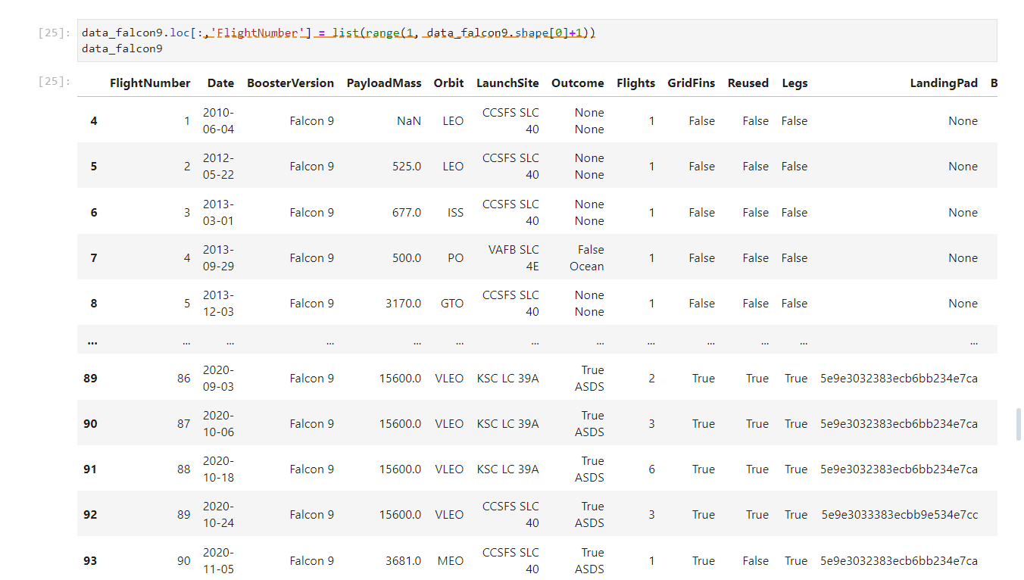
Data Collection – SpaceX API
SpaceX API REST Call
Retrieving Data
Relevant information extraction
Storing Data
https://github.com/HughesDatalab/HughesDatalab/blob/main/jupyter-labs-spacex-data-collection-api.ipynb
End

Slide 9
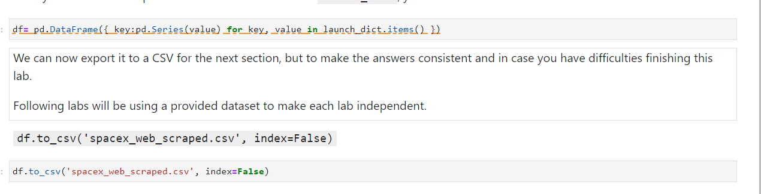
Data Collection - Scraping
WEB PAGE REQUEST
Extracting column names: parsing HTML with BEAUTIFUL SOUP
Creation of a Pandas DataFrame
https://github.com/HughesDatalab/DataLab1/blob/main/jupyter-labs-webscraping.ipynb
End

Slide 10
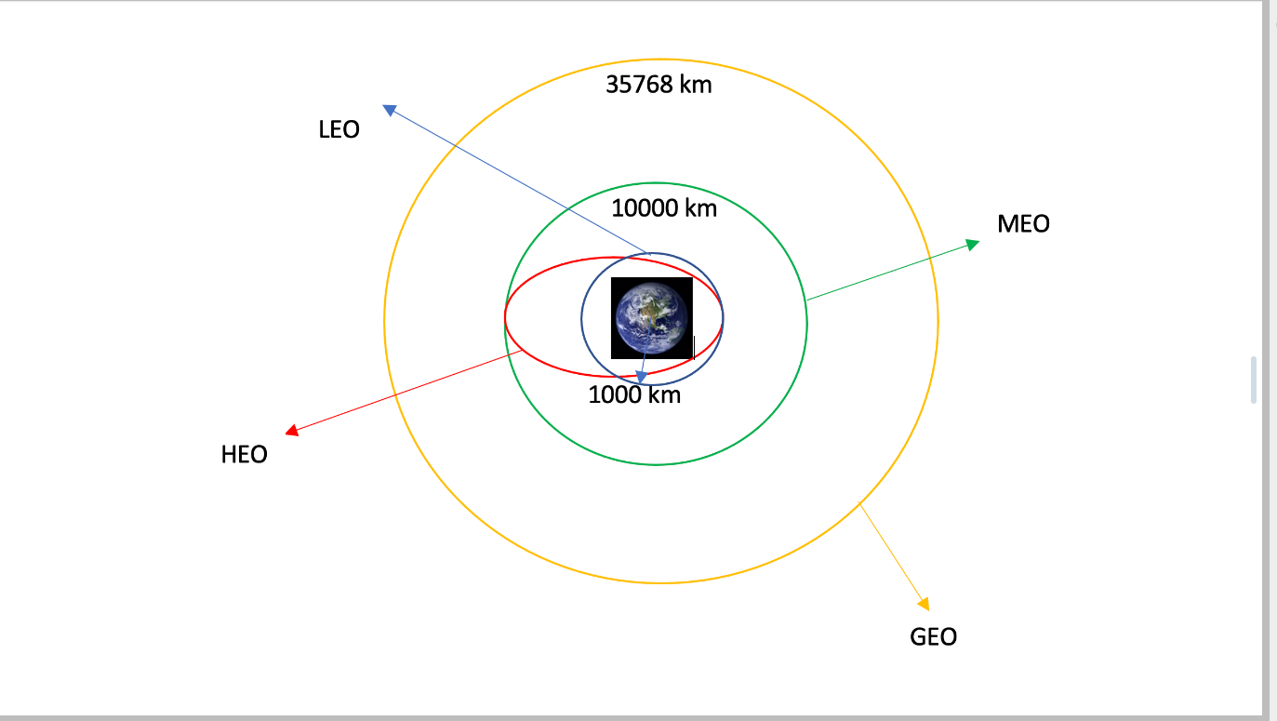
Data Wrangling
Calculating number of launch sites
Calculating the number and occurrence of each orbit
Calculating the number and occurrence of each outcome
https://github.com/HughesDatalab/DataLab1/blob/main/labs-jupyter-spacex-Data%20wrangling.ipynb
Creating a landing outcome label

Slide 11
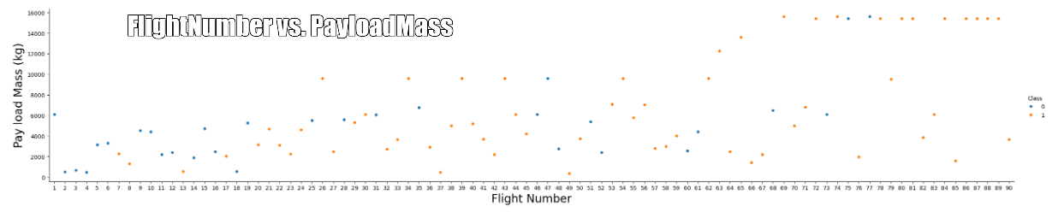
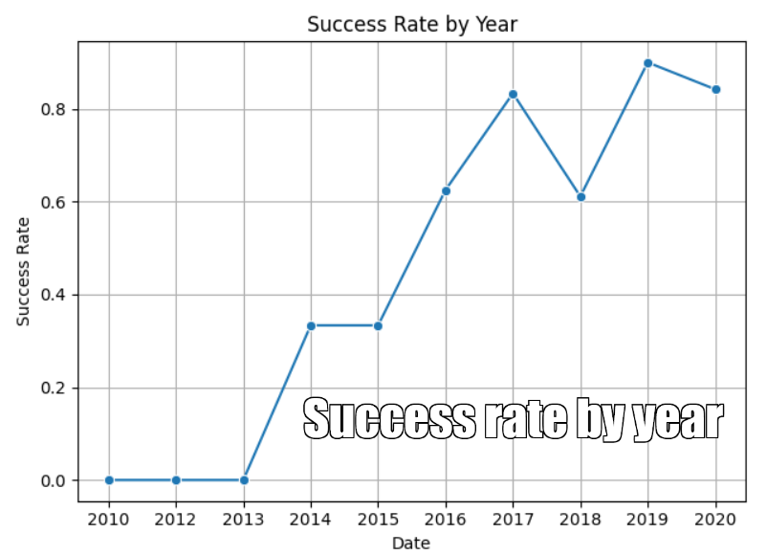
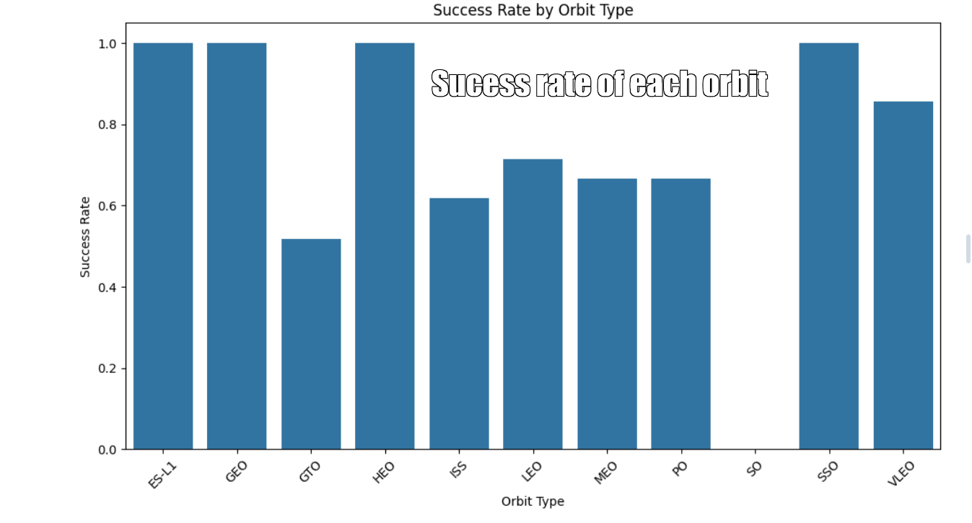
EDA with Data Visualization
https://github.com/HughesDatalab/DataLab1/blob/main/edadataviz.ipynb

Slide 12
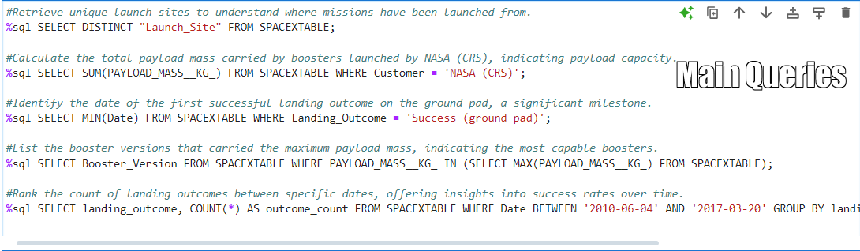
EDA with SQL
Overview of SpaceX data
Loading dataset in corresponding table in Db2
Executing SQL queries
https://github.com/HughesDatalab/DataLab1/blob/main/jupyter-labs-eda-sql-coursera_sqllite.ipynb

Slide 13
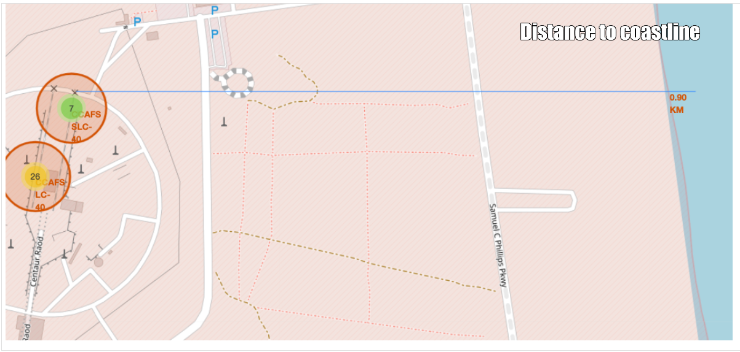
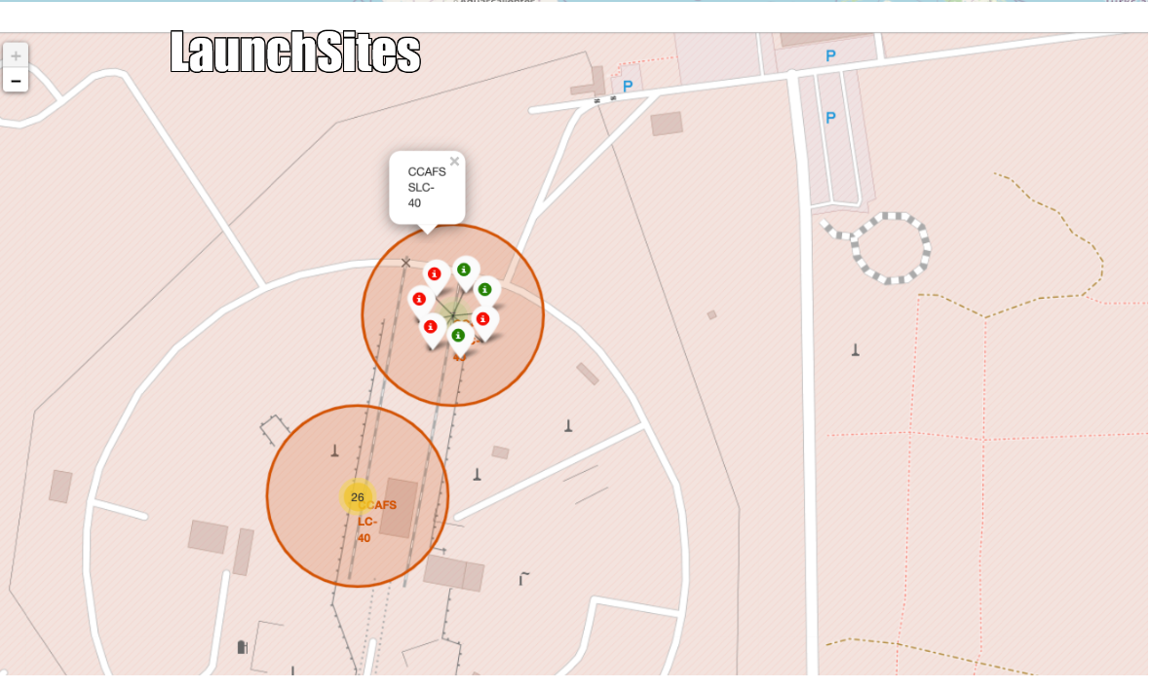
An Interactive Map with Folium
Marking launch sites on map
Marking success/failure for each site on the map
Calculating the distance between a launch sites and it’s proximities
https://github.com/HughesDatalab/DataLab1/blob/main/lab_jupyter_launch_site_location.ipynb

Slide 14
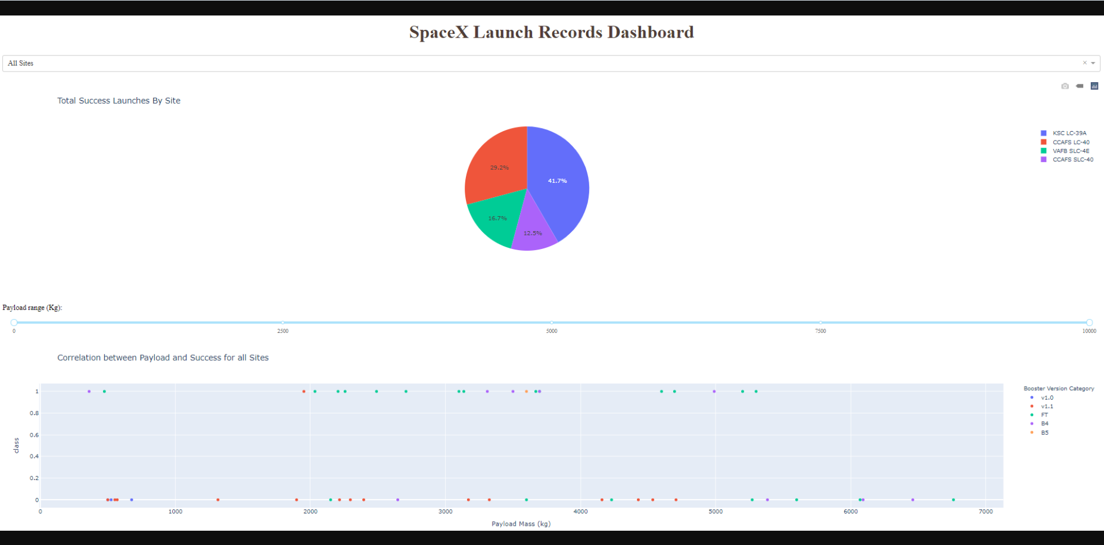
Build a Dashboard with Plotly Dash
Dropdown menu: Allows users to select a specific launch site.
Pie chart: Displays the total count of successful and failed launches for all sites or for a specific site selected from the dropdown menu.
Range slider: Enables users to select a payload mass range.
Scatter plot: Shows the correlation between payload mass and launch outcome (success or failure) for all sites or for a specific site within the selected payload range
https://github.com/HughesDatalab/DataLab1/commit/80eb87bfb591fca08d89adb01e4c63bb889be9fb

Slide 15
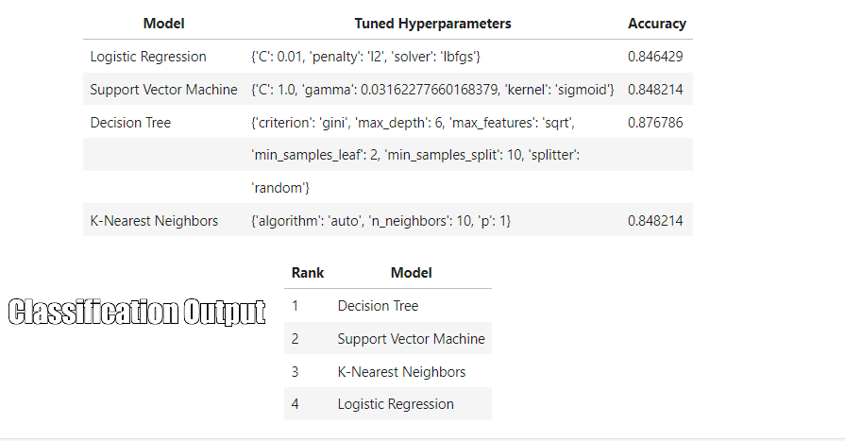
Predictive Analysis (Classification)
Model Exploration and Training: Explored several classification algorithms including Logistic Regression, Support Vector Machine (SVM), Decision Tree, and K-Nearest Neighbors (KNN).
Hyperparameter Tuning: Conducted hyperparameter tuning for each model using GridSearchCV to optimize their performance.
Evaluation and Selection: Evaluated the performance of each model using test data and selected the best-performing model based on accuracy. The best performing model was Decision Tree.
https://github.com/HughesDatalab/DataLab1/blob/main/SpaceX_Machine_Learning_Prediction_Part_5.jupyterlite.ipynb

Slide 16

Results

Slide 17
CONCLUSION
- Exploratory Data Analysis (EDA) revealed various insights into SpaceX launch data, including trends in launch outcomes, payload masses, and launch sites.
- The Interactive Analytics Demo facilitated intuitive exploration of launch data, enabling users to visually analyze launch outcomes and trends interactively.
- Predictive Analysis using machine learning models such as Logistic Regression, Support Vector Machine, Decision Tree, and K-Nearest Neighbors, aimed to forecast launch success.
- The Decision Tree model emerged as the most accurate predictor of launch outcomes, offering valuable insights into factors influencing successful launches.

Slide 18
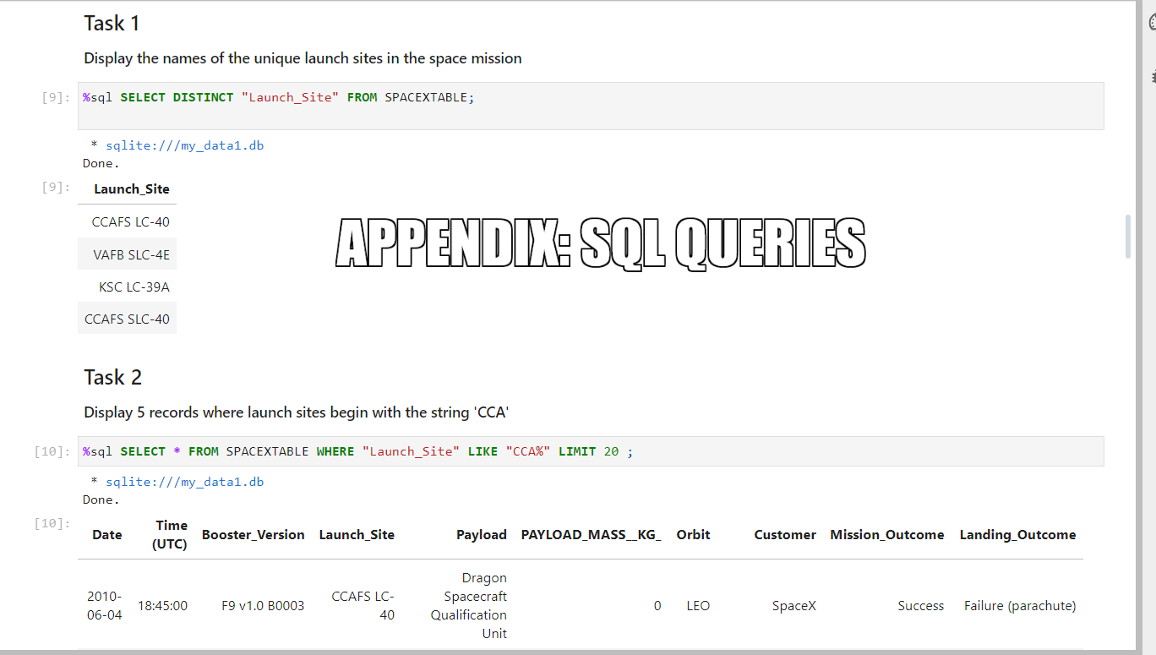
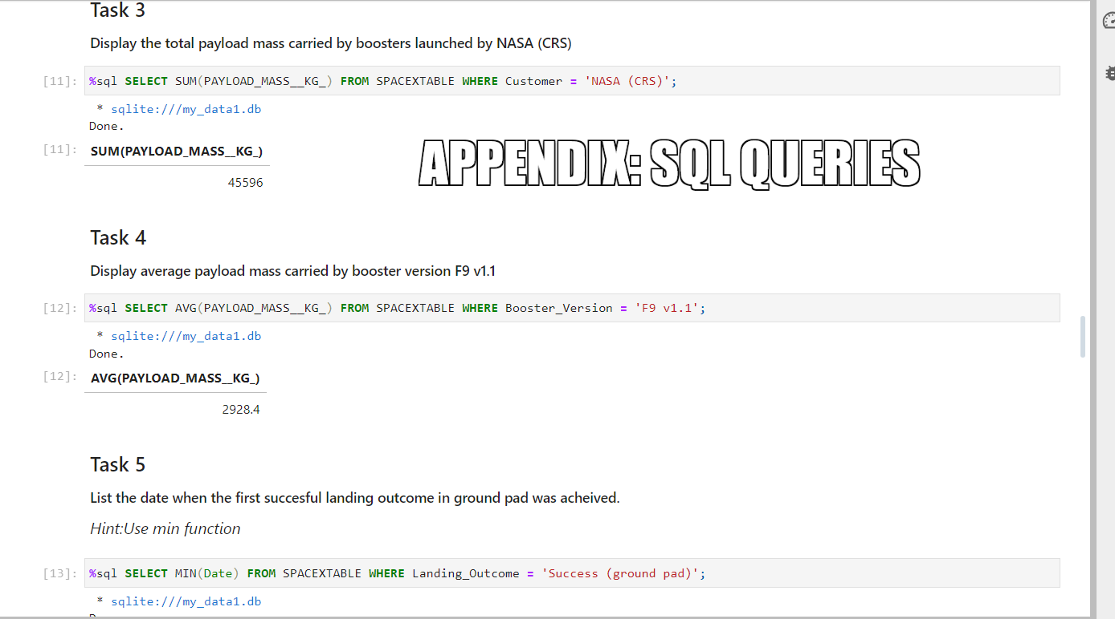
Appendix

Slide 19
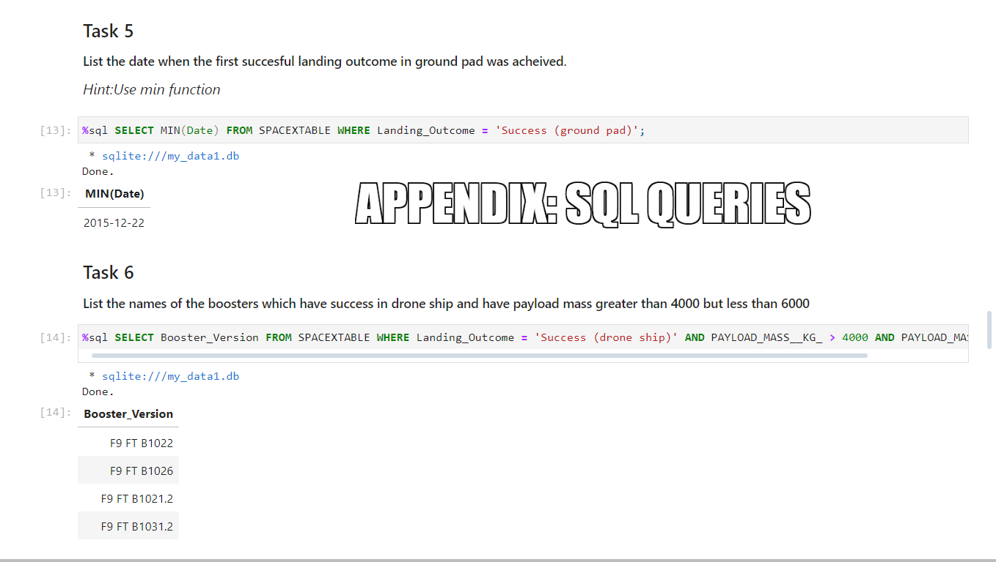
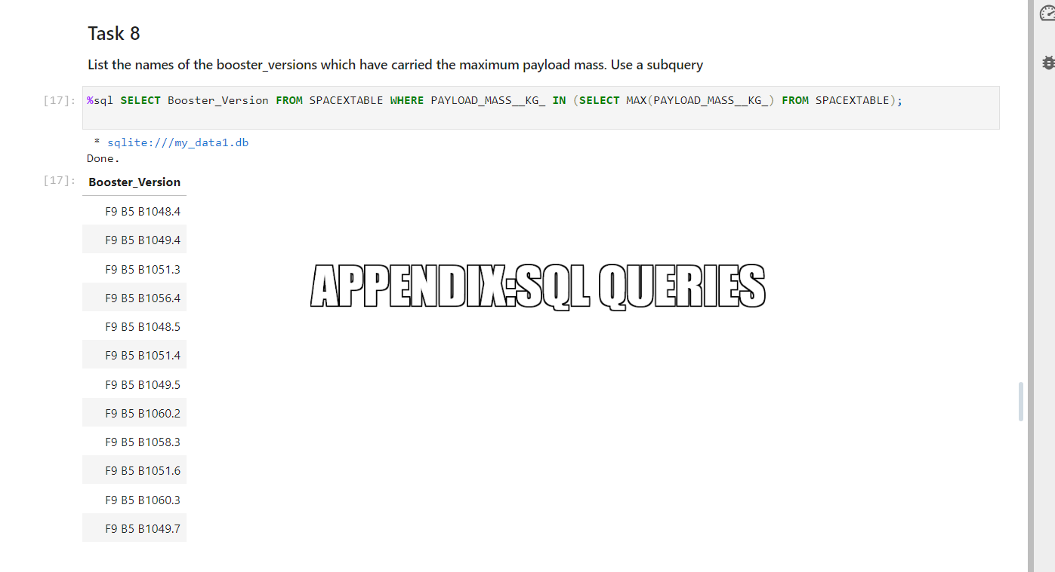
APPENDIX

Slide 20
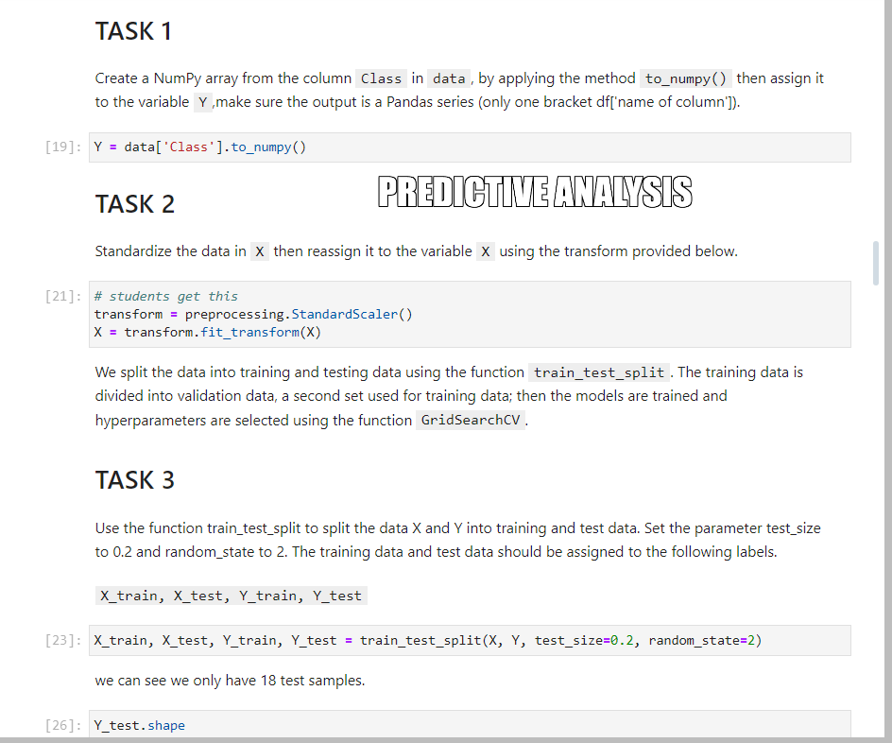
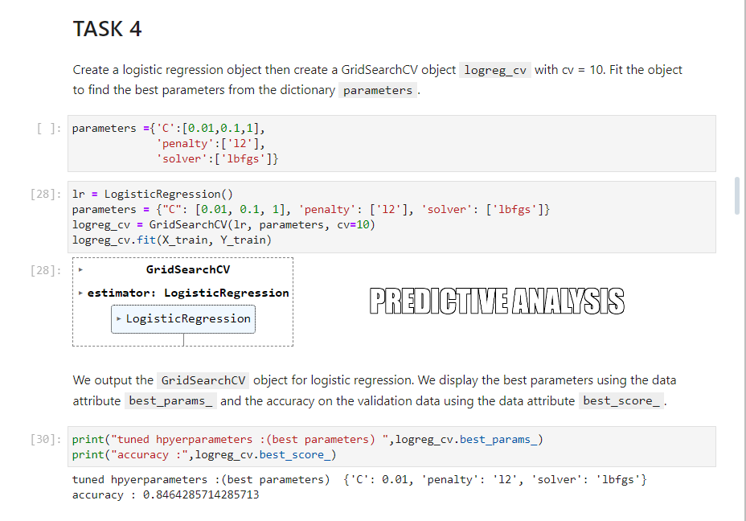
APPENDIX

Slide 21
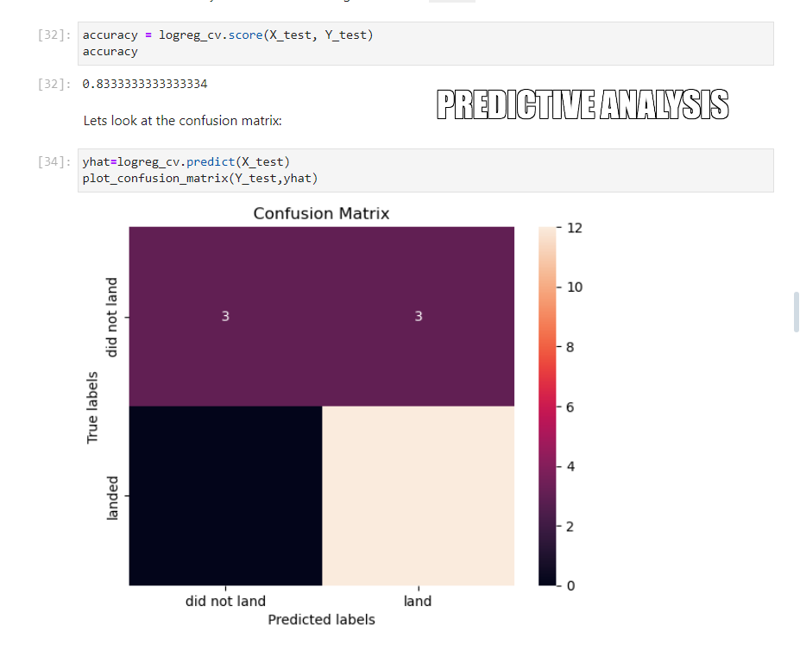
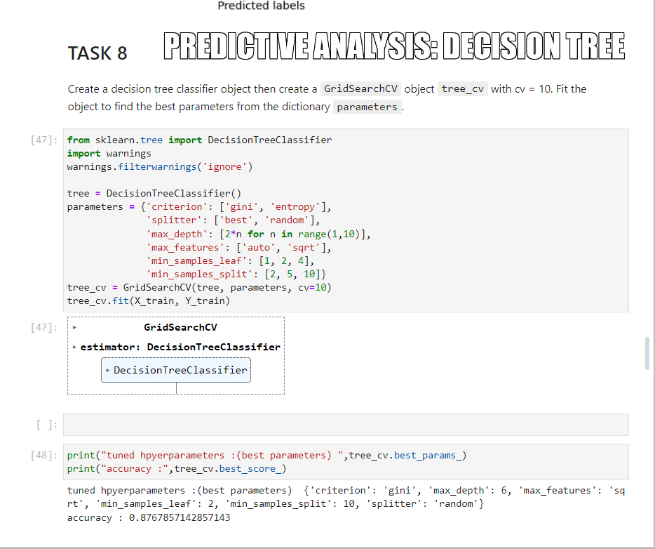
APPENDIX

Slide 22
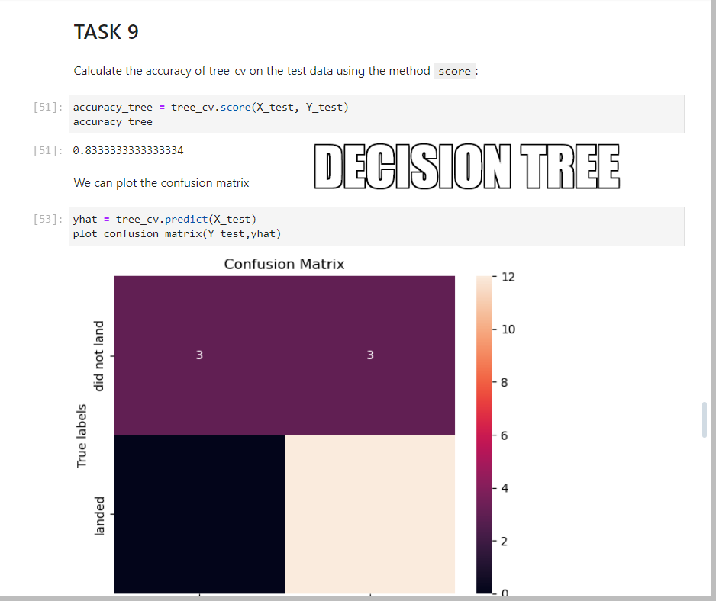
APPENDIX

Slide 23


